Slide 1
VA - Roman Empire
A tool for educational purposes, mainly to give a visual representation of ancient Roman battles and wars

Slide 2
“So great is the military glory of the Roman People that when they profess that their Father [...] was none other than Mars, the nations of the earth may well submit to this also with as good a grace as they submit to Rome’s dominion.“
~ Titus Livius
Idea: develop a visual analytics tool to learn about Roman wars and battles

Slide 3
Dataset

Slide 4

Mining
commanders
Battles
places
outcome
allies
...
...
Wars
sources
info

Slide 5
Preprocessing
Pleiades identifier
static MCA
Wikidata binding

Slide 6
Visualization

Slide 7
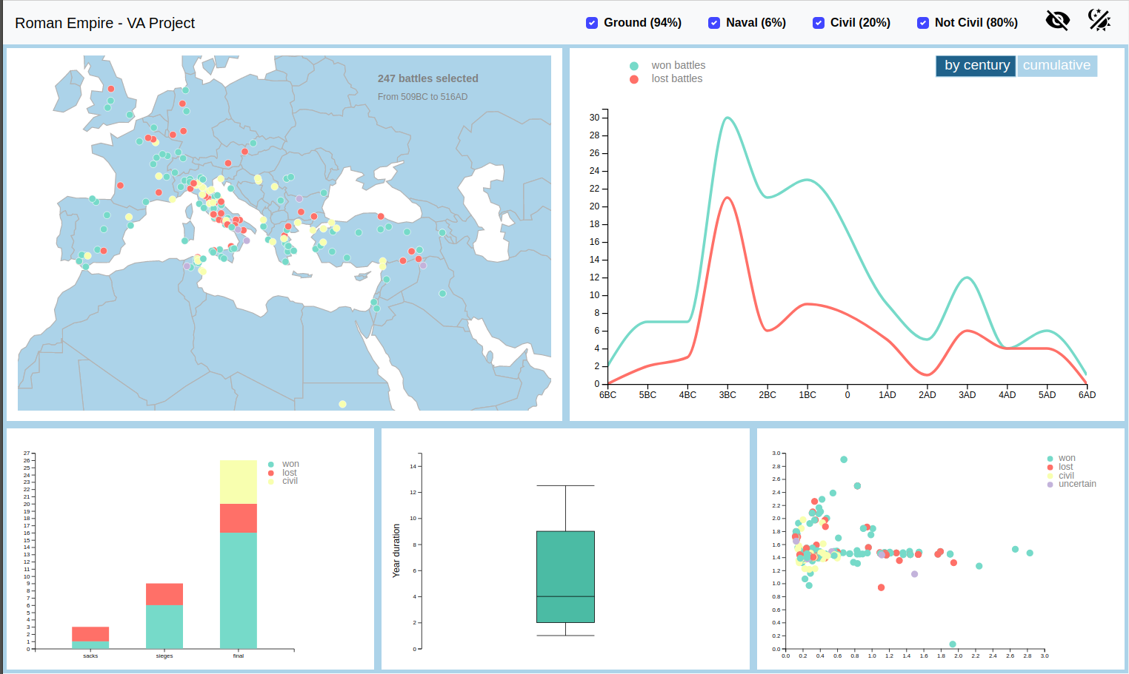
Overview
5 graphs
simple filters
dark mode
blind-safeness
...

Slide 8
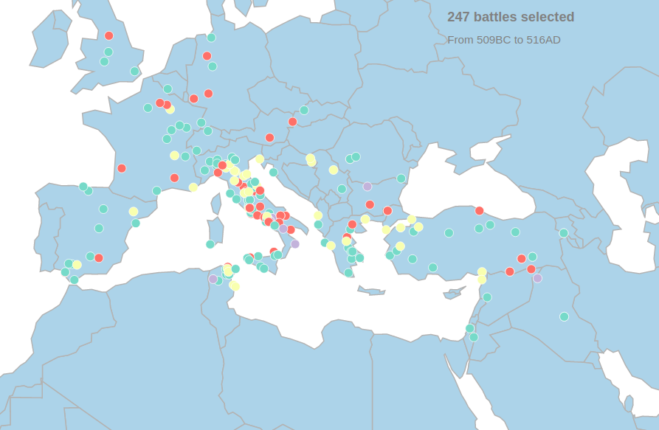
Geographic Map
clear event visualization
color encoding for outcome
brushing
simple analytics
battle details
Wikidata link

Slide 9
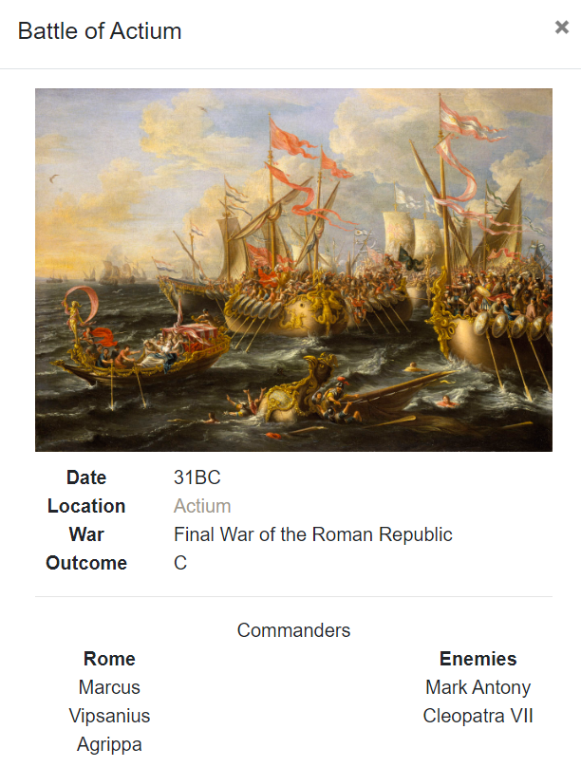
Modal
Event details
Date, Location, Outcome, ...
Commanders
Allies
Strength and losses
Wikidata link
Pleiades link

Slide 10
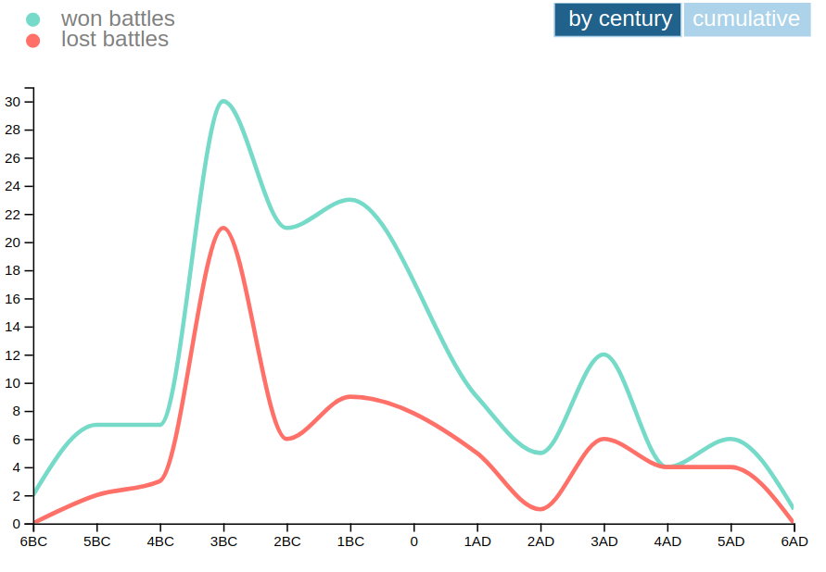
Line Chart
battles outcome
by century
cumulative
brushing + zoom

Slide 11
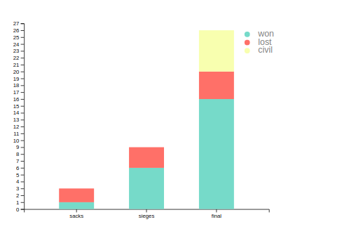
Stacked Bar Chart
battles type
color encoding for outcome
tooltip for fast and error-prone results

Slide 12
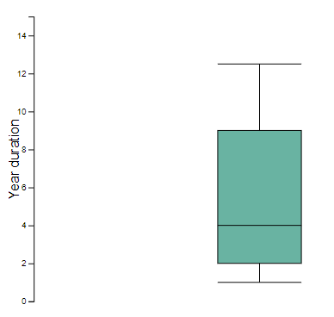
Box Plot
wars duration

Slide 13
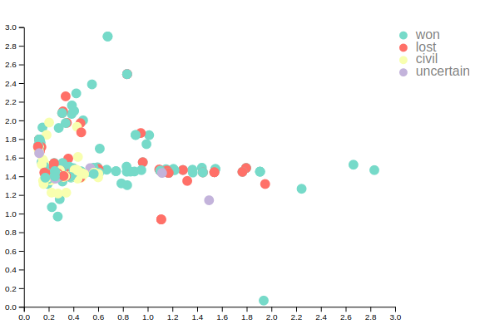
Scatter Plot
MCA
homogenous color encoding
brushing

Slide 14
Header
simple filters
dark mode
blind-safeness

Slide 15
Coordinated Interactions
Geographic Map → *
brushing triggers an update, filtering the underlying dataset of all the other views
Line Chart → *
brushing + zoom triggers an update and filters the dataset
Scatter Plot → Geographic Map
brushing changes the style of the points on the map

Slide 16
Conclusions

Slide 17
Main benefits
the possibility to select and filter data
an instant visual information of the selected events
some basic analytics
hyperlinks for further details

Slide 18
The next future
dataset extension
predefined filters
dynamic boundaries

Slide 19
Thank you

